Slide 1
EE 74099 / EN 74099 Research Project
Progress Presentation For The Final Year Project
29.10.2019
Project title: Order Management System And Vision Based Autonomous Delivery Robot For Restaurants
Members:
ANFM. Begum, GSU. Ahmadh & IIS. Prema Sri
Supervised by : Dr. WGCW Kumara & Eng. MFM. Abdul Cader
Department of Electrical and Telecommunications Engineering
Faculty of Engineering
South Eastern University of Sri Lanka

Slide 2
Content
Progress on the Robot Design and Control
Progress on Robot Path planning and Navigation
Next Steps

Slide 3
Progress on the Robot Design and Control

Slide 4
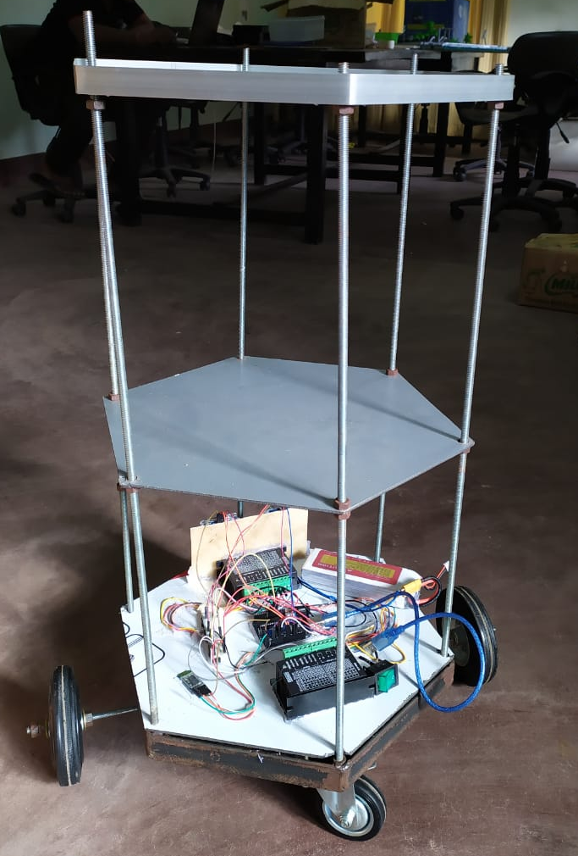
Robot Chassis Building
We have finished the mechanical building of the robot design.
Currently robot platform accepts navigation commands through Bluetooth.

Slide 5
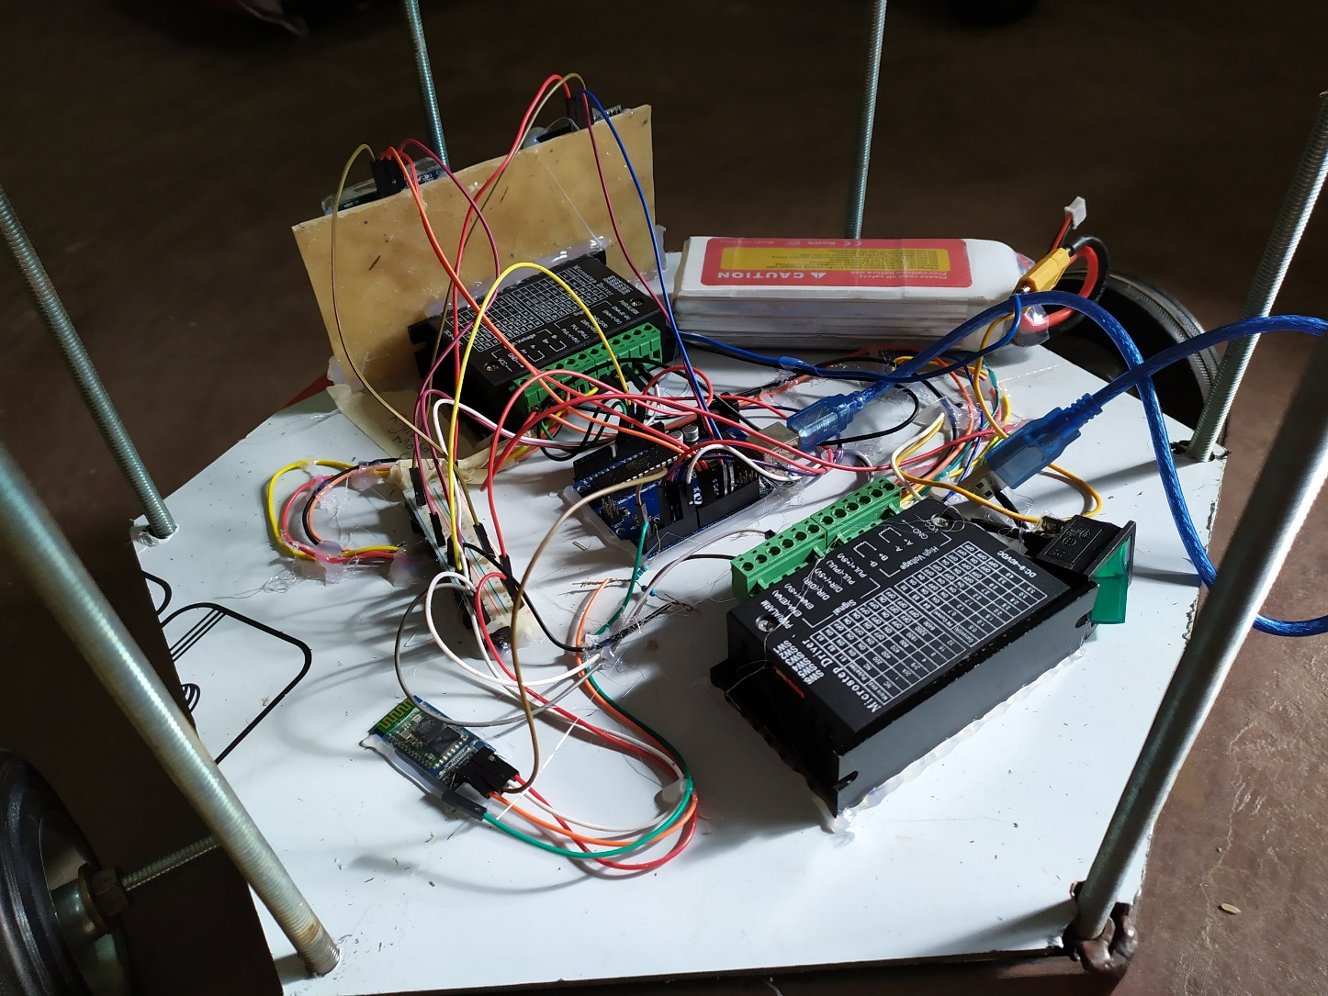
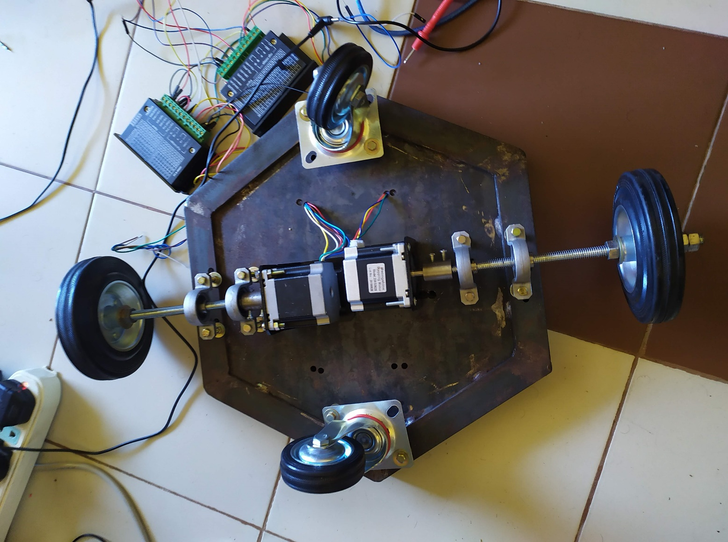
Arduino Uno Microcontroller board
TB6600 Stepper Motor Driver
Ultrasonic Sensors
Bluetooth Module
NEMA 23 Stepper Motors
Caster wheels
6000mAh Lipo Battery

Slide 6
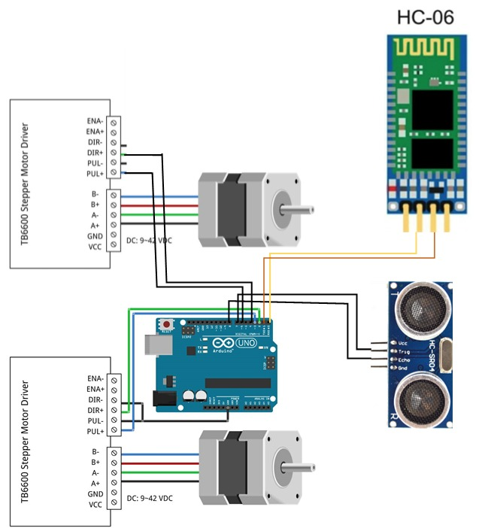

Building the robot

Slide 7
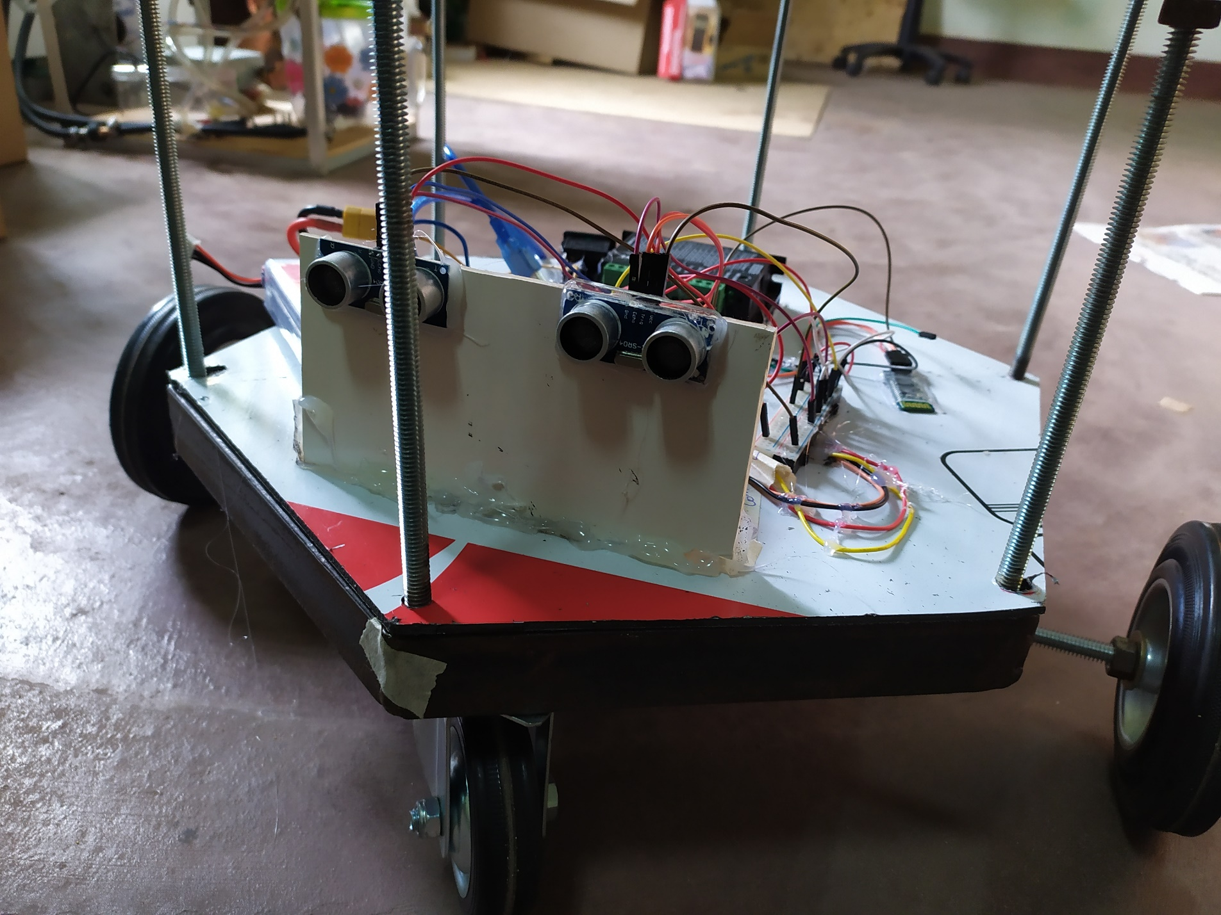
Obstacle Detection
Ultrasonic Sensors detects if any obstacles suddenly come across its path.
Robot then send the current position to the navigation system for path regeneration.

Slide 8
Communication Between Navigation System and Robot Platform
Sending Step Counts and rotation angles to move
Navigation System
Sending current position when obstacle is encountered for path regeneration

Slide 9
Robot Movement
Camera captures and generate path.
Robot will navigate by receiving directions and step count from node to node.
If an obstacle is detected by ultrasonic sensor, it will request for a new path from navigation system.

Slide 10
Path planning and Navigation

Slide 11
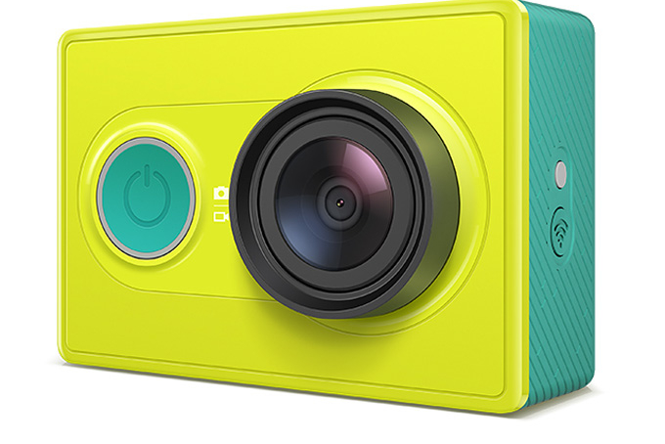
Camera
Up to now, we have been experimenting with YI Action Camera
We mounted the camera and took pictures of different occasions
And then we processed the pictures with the algorithms to generate maps and so forth.

Slide 12
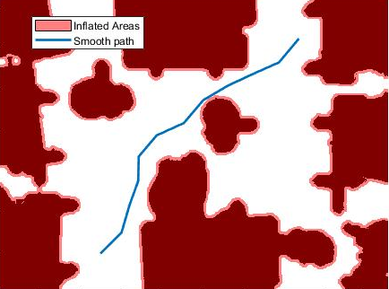
Path Planning
Path Planning algorithm generates set of points from starting point to end point.
We need to generate C++ code from MATLAB code for path planning algorithm to implement it on Jetson Nano platform.

Slide 13
Next steps

Slide 14
Next steps
Implementation of calculations of navigation system
Code Generation from Matlab and implementation on Jetson Nano

Slide 15
Thank You

